Slide 1
Quick Reference Card
SEA T&T

Slide 2
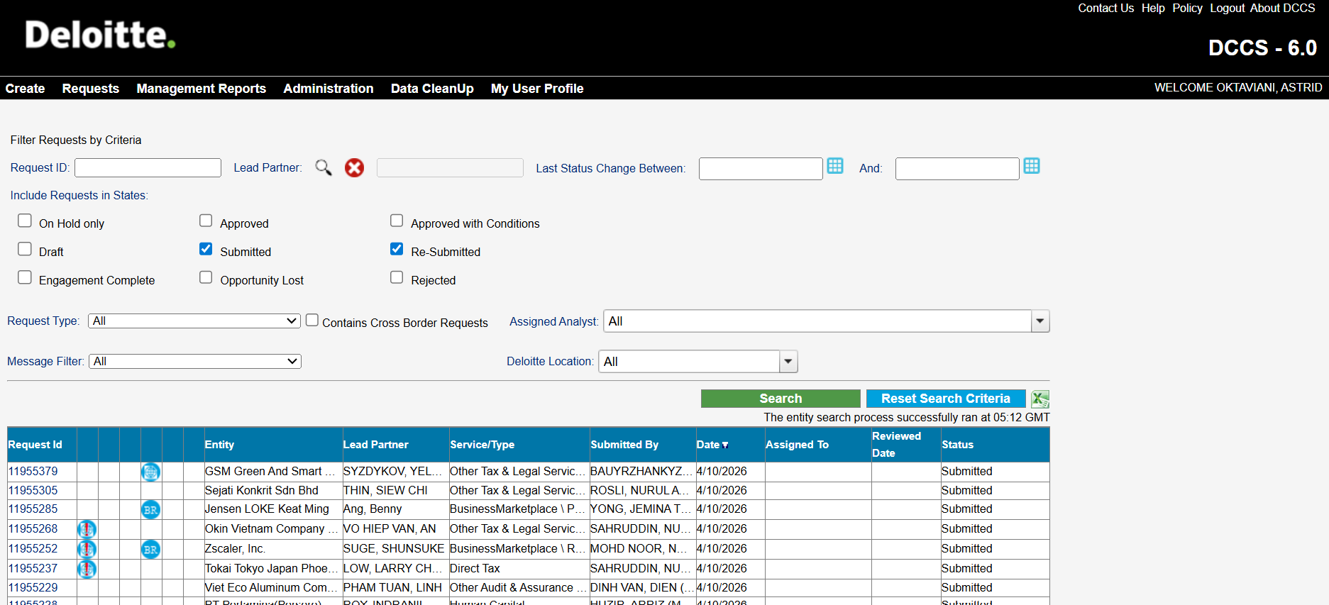
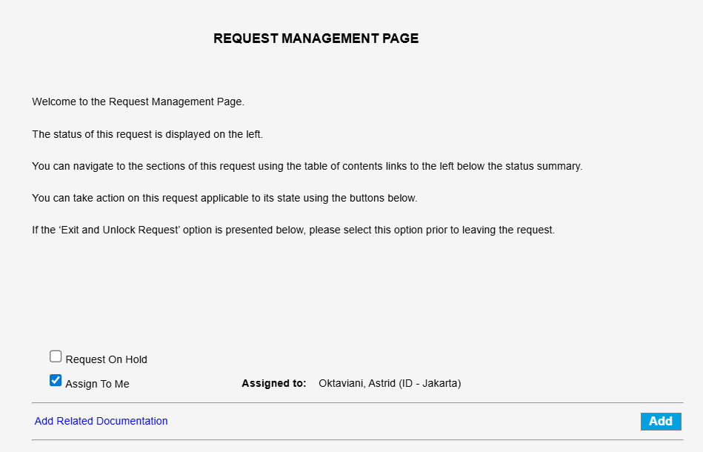
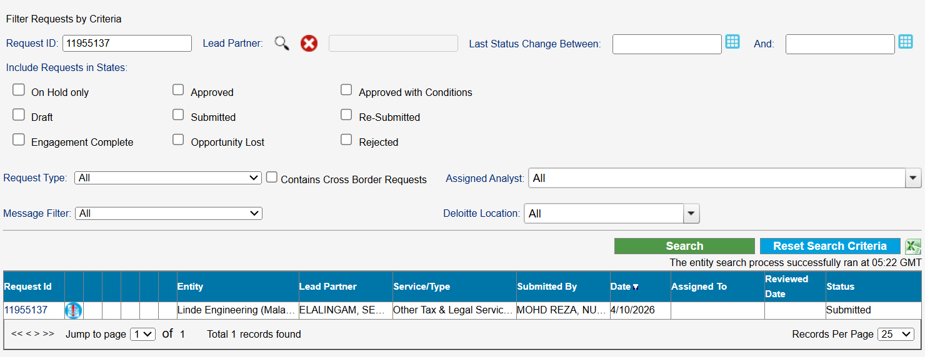
Assigning DCCS Request
Go to DCCS system: https://dccs.deloitteresources.com/dccs/AnalystUI/AnalystHome.aspx
Search the Request ID and click “search” button
Once the DCCS Request ID appears, click on the Request ID and you will be directed to the Request Management Page
In the Request Management Page, click “Assign to Me” button. Then, your name will appear in the “Assigned to” column.

Slide 3
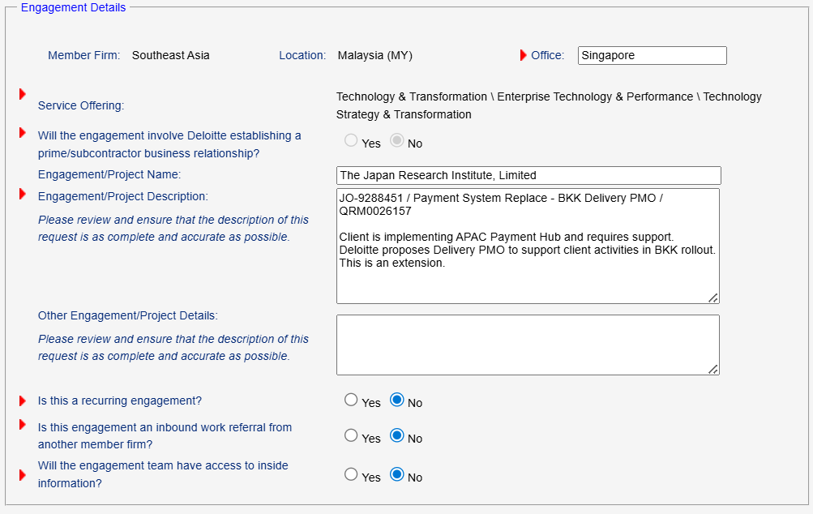
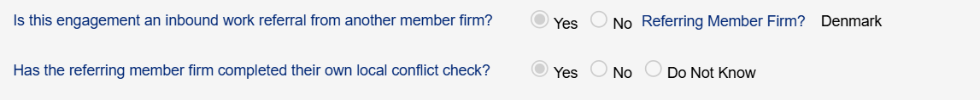
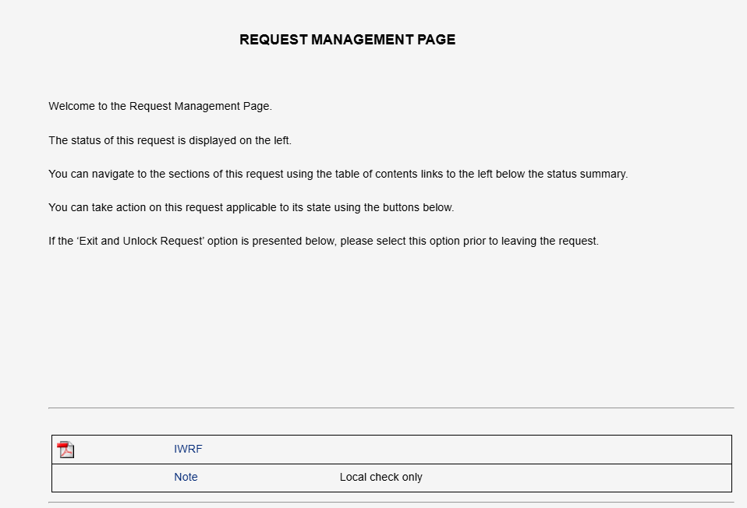
Perform Quality Check – Engagement Details
Verify consistency between the service offering and engagement details. Analyst should re-confirm with the requestor if there is any inconsistency for example:
The selected service offering is T&T, but the engagement details is an Audit/Assurance engagement
The engagement details only include name of Client entity, but do not include any scope of services
Check if request is for referral work or not under “Is this engagement an inbound work referral from another member firm?”.
If requestor indicates “Yes”, check if there is any IWRF and/or confirmation from the requestor in Request Management Page if this is for local entity check only.
If IWRF and confirmation of performing local entity check has been obtained from ET/Gov. team, please proceed to perform local entity check only.
If no IWRF or confirmation provided, analysts should re-confirm with ET/Gov. team whether this is for local entity check only.
If request submitted by Governance team, only contact the Gov. team or the requestor if key information appears incomplete or inconsistent
Referral Work

Slide 4
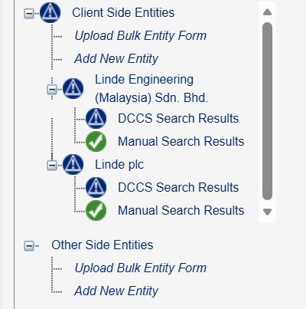
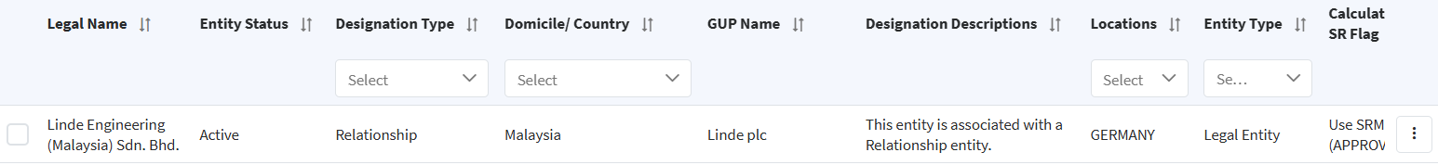
Perform Quality Check – Relevant Parties
Verify consistency all relevant parties under “Client Side Entities” section in DCCS have been included
[Client Side: Client, controlling shareholder (entity/individual), GUP, individual who controls GUP. Other Side: Other-Side party, controlling shareholder (entity/individual), GUP, individual who controls GUP] – please see relevant parties QRC: Quick Reference Card Identifying Client Side of Non-Assurance Relevant Party.pdf
Make sure key information such as entity name, country location, and GUP matches DESC information. DESC should always be treated as the correct source over what’s in the submitted DCCS request.
If inconsistencies in DESC are found:
Contact the requestor to clarify.
If requestor confirmed that the submitted entities are correct (or DESC information is outdated), please contact the SEA DESC team at SEAIndependence@deloitte.com, and copy the assigned Senior Analysts from both the Conflicts and DESC teams, including: Benedict Jarlego – bjarlego@deloitte.com.
Follow up actively and wait for the DESC team’s response before proceeding with request processing.
Common DESC inconsistencies include:
The GUP in DESC differs from what’s in the submitted request.
A relevant party in the submitted request does not carry the correct DESC designation, such as missing a Restricted designation when it’s identified as affiliate of a Restricted Entity.

Slide 5
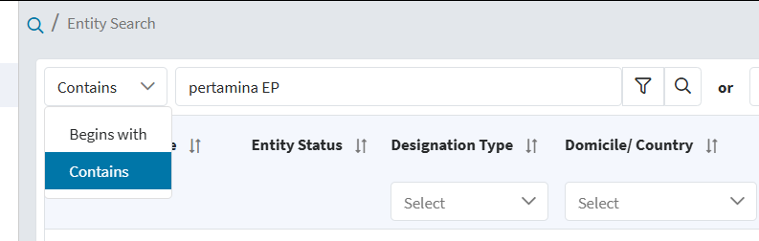
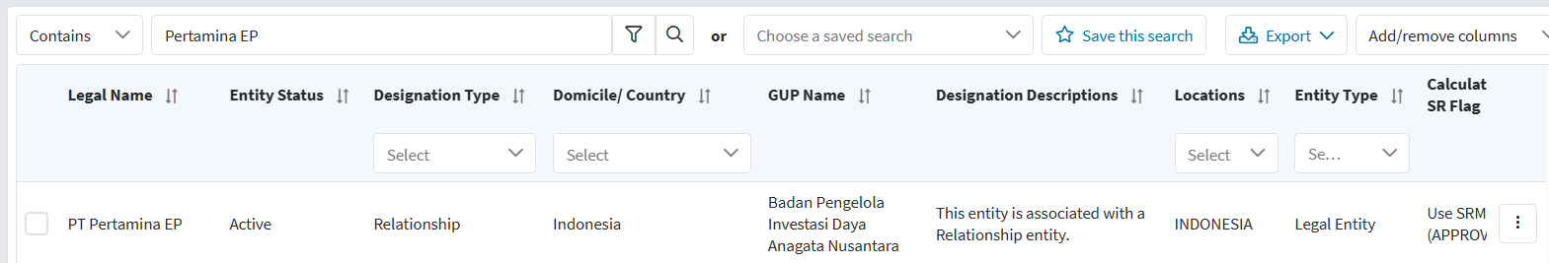
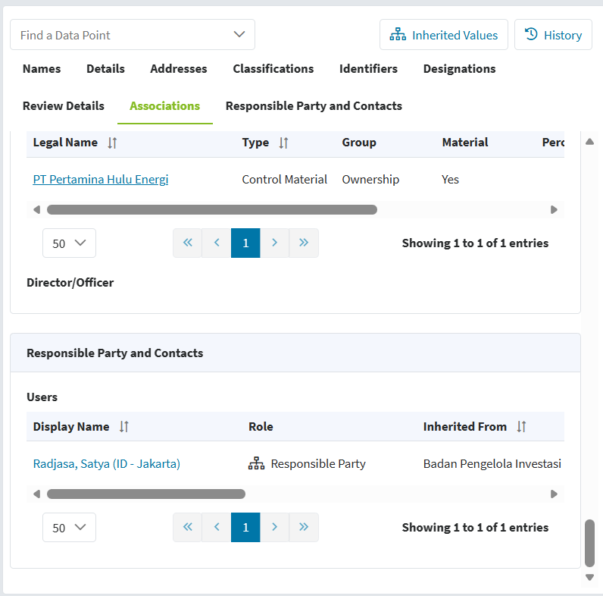
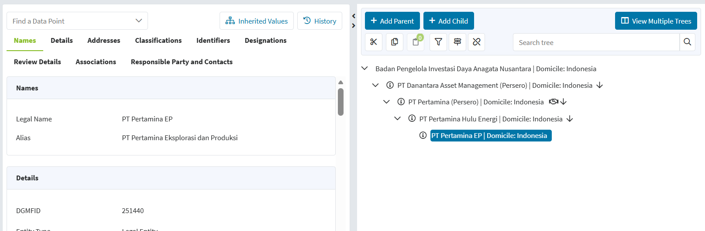
Perform Search to Conflicts Databases – DESC
Go to DESC : EMS UI | Legal Entity Search
Search the entities/individuals in DESC and then click the button with the Search image. You may filter the search by using “Contains” and/or “Begins with” feature.
If a match hits for the entity/individual, then check under the designation type (i.e. Relationship, DTT/SEC/EUPIE Restricted, Reverse Restricted, Watchlist, Loan Rule, Business Relationship Restricted) and include this match in the table summary result.
Note: For none-designated match, no need to include in the table summary but include the caveat in the “Condition to be satisfied”.
Analysts may check the entity DESC tree and name of DESC LCSP/RP in DESC by clicking the entity in DESC. Then, you will be directed to a page where the details of DESC information shown (e.g. Legal Entity Name/Alias, Address, DESC tree, DESC LCSP/Responsible Party)
To Check Entity’s DESC Tree
To Check DESC LCSP/RP

Slide 6
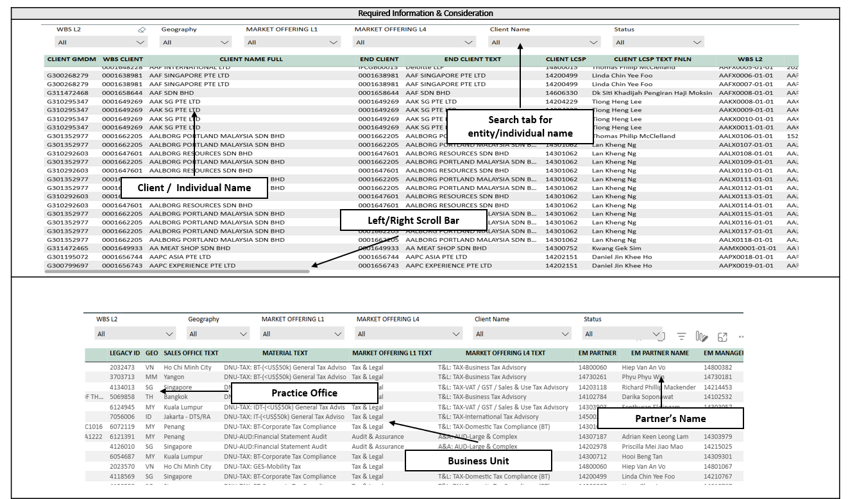
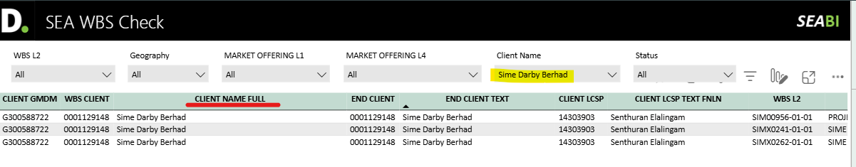
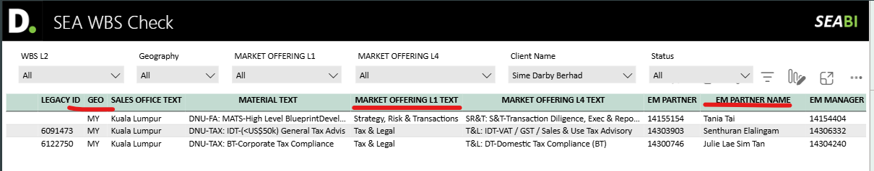
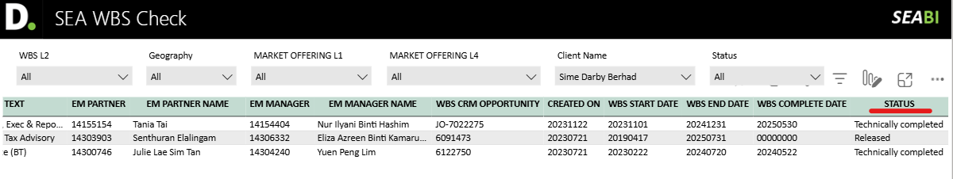
Perform Search to Conflicts Databases – WBS
Go to WBS Listing Database: SEA WBS Check - Power BI
Search the entities/individuals in WBS under “Client Name Full”.
If a match hits for the entity/individual, check the Client/Individual Name, Practice Office, Business Unit, Partner’s name, as well as Status, and include this match in the table summary result.
For Business Unit, please indicate whether the nature of the identified match is Non-Assurance, Assurance or Audit in table summary result.
If under T&L, SR&T, T&T : should be indicated as “Non-Assurance”
If A&A : should be indicated as “Audit” only if the following shown:
Market Offering L4: A&A: AUD-Large & Complex
WBS Text (contains): Statutory, Financial Statement
If A&A : should be indicated as Assurance only if the following shown:
Market Offering L4: A&A: AUD-Large & Complex
WBS Text (contains): Assurance, Attestation, ISAE
If A&A : should be indicated as “Non-Assurance” if not fall under point b) and c) above.
For Status, please indicate the Ongoing match. see below guidance:
If Released: should be indicated as “Ongoing”
If Technically Completed: should be indicated as “Completed” – no need to include completed engagements unless the completed match is an Audit engagement which has been recently completed and still indicated as Restricted entity in DESC.
For completed match, you may check the completion date under “WBS Complete Date”.
Sample Case

Slide 7
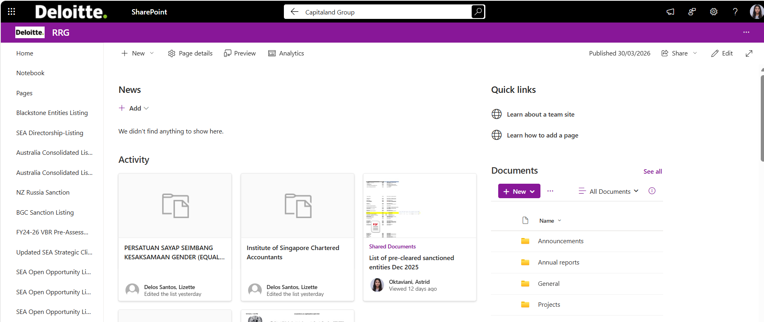
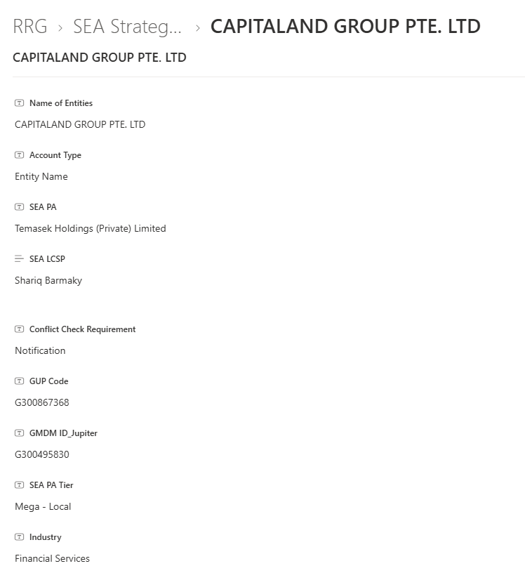
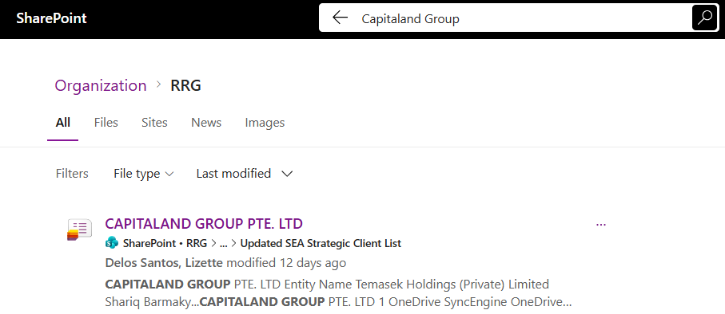
Perform Search to Conflicts Databases – New One Window (Sharepoint)
Go to New One Window (Sharepoint): https://apcdeloitte.sharepoint.com/sites/SEA/RRG/SitePages/CollabHome.aspx
Search the entities/individuals in the new One Window under the search bar at the top.
If a match hits for the entity/individual for the following databases (see point A – D below), please include the matches in the table summary result and/or DCCS conditions.
Strategic Client
If a match hits, click on the match and check under Entity Name, SEA LCSP and conflict check requirement (approval/notification), and include this match in the table summary result.

Slide 8
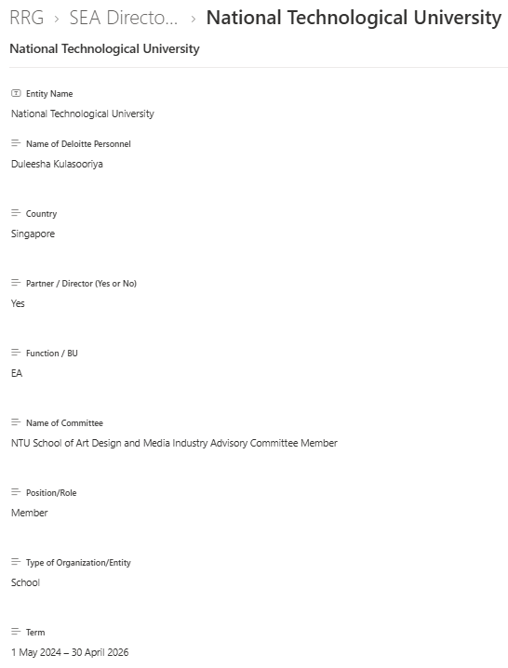
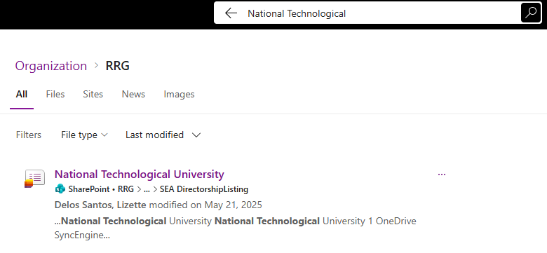
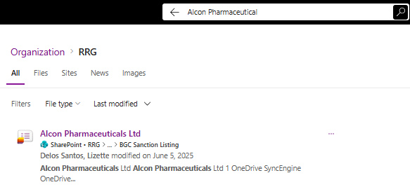
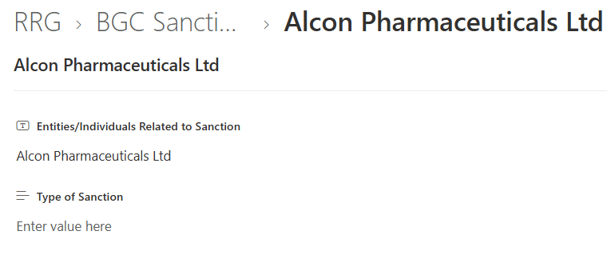
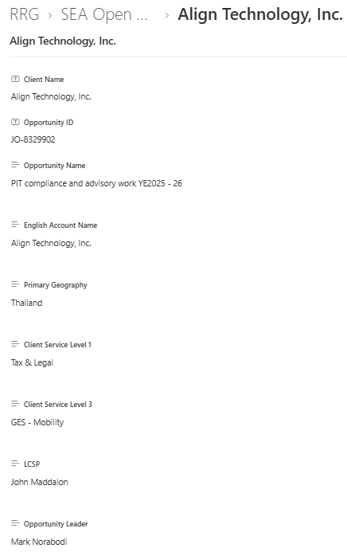
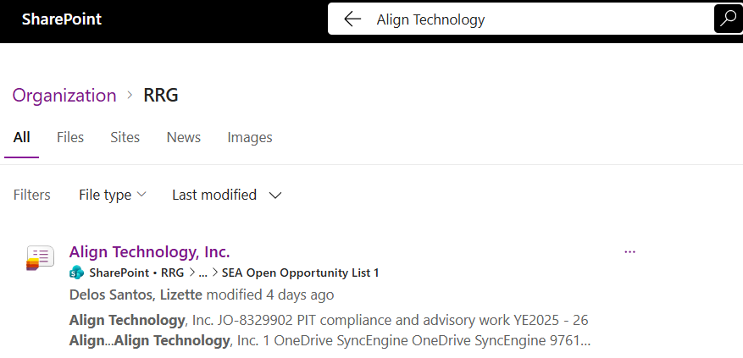
Perform Search to Conflicts Databases – New One Window (Sharepoint)
Directorship Listing
If a match hits, click on the match and look under the Entity Name and the Country, and include this match in the DCCS condition (no need to include in the table summary result).
You need to send a notification email to BRL (copy CRL) for a directorship match and include the following information (Entity Name, Name of Committee, Position/Role, Type of Organization and Term.
Sanction Match
If a match hits, click on the match and look under Entity Name.
Analysts need to inform ET to perform KYC check prior sending CB request to other member firm via DCCS system (if any) or prior issuing the final result via DCCS system.
Open Opportunities Listing
If a match hits, click on the match and look under Entity Name, Client Service Level 1, Country and Opportunity Leader, and include this match as “Pursuing” in the table summary result.

Slide 9
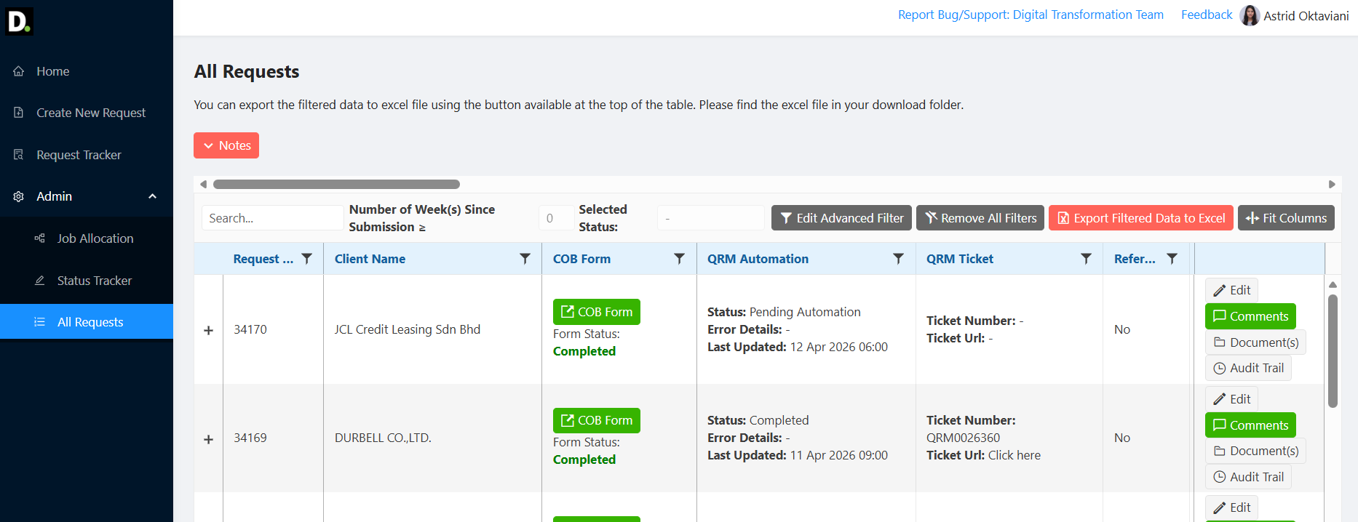
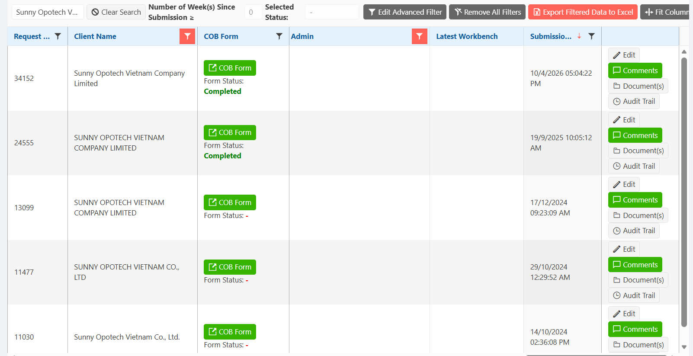
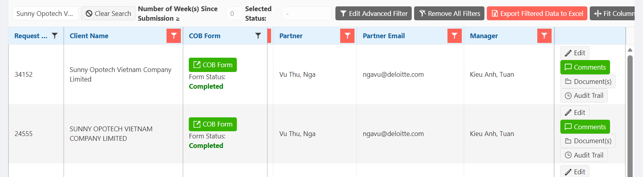
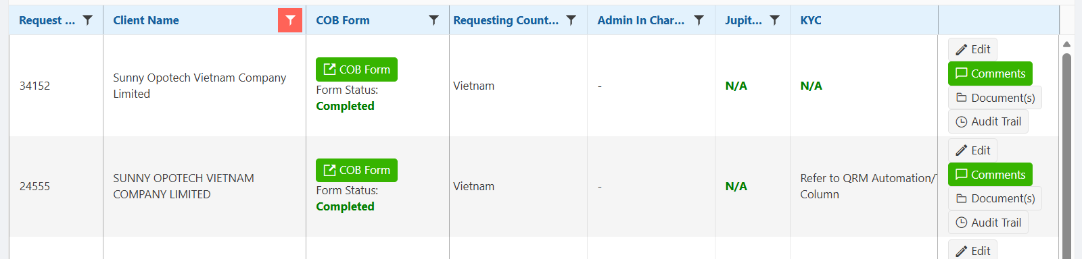
Perform Search to Conflicts Databases – COT
Go to COT database: Client Onboarding Tool
Search the entities/individuals in COT under the search bar and click “enter” on your laptop.
If a match hits for the entity/individual, then you will look at the Client Name, Country, Partner, as well as Submission Time, and include this match in the table summary result.
Only acknowledge the match if Submission Time is from 15 Jul 2025 onwards (no need to acknowledge matches prior 15 July 2025).
All matches identified in COT are Ongoing and from Tax BU (Non-Assurance in nature)

Slide 10
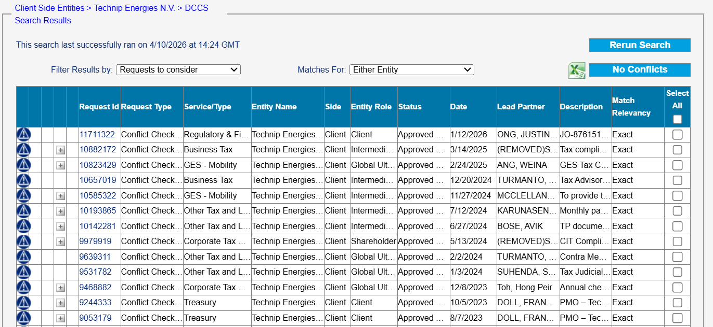
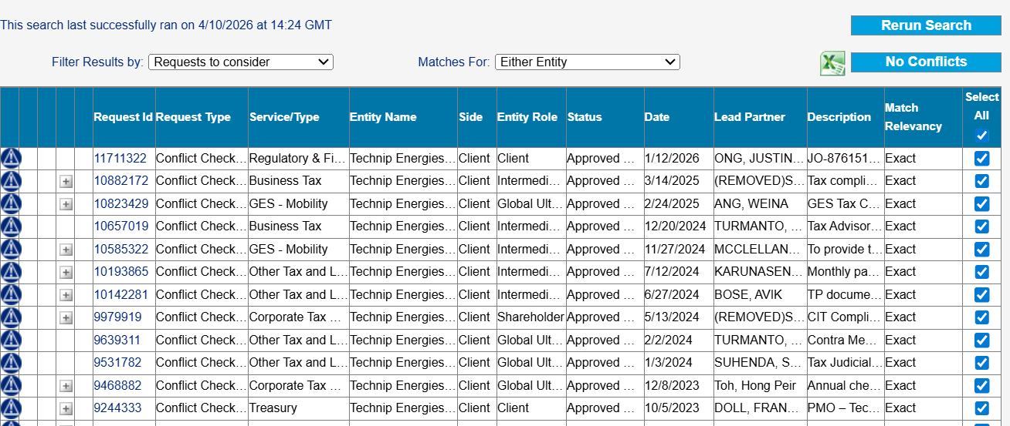
Perform Search to Conflicts Databases – DCCS Search Result
Go to DCCS Search Result feature in DCCS Request.
If there is an Exact Match hits (or referring to the same entity name included in DCCS request), check whether the identified matches are relevant matches. You may also click on the DCCS Request ID to see detail of the identified match in the request.
What is the entity role in the identified matches? (check the table from [insert link for approval from approval matrix] for Matches consideration)
When is the submission date of the identified DCCS Request from DCCS search result match? For prior 2 years submission date, no need to include the match.
What is the Status of the match? If it’s indicated as “Engagement Complete” or “Opportunity Lost”, no need to include the match.
Has this DCCS search result match already included in WBS/One Window? have already been included in WBS/One Window? If yes, no need to include the match again.
If point a) – d) has been considered as a relevant match, please include the match in DCCS result as “Pursuing”. Please check the Service Offering and/or Engagement Details of the identified matches to indicate the match as “Non-Assurance”, “Audit”, or “Assurance”.
Then, select all the matches in DCCS Search Result (those matches with no action required/no potential conflicts), and click “No Conflicts”.

Slide 11
Perform Cross-Border Conflict Check Request to other Member Firms
Check if Cross-Border check is required to be sent to other Member Firms based on the below criteria
SCENARIO |  | ACTION REQUIRED
Foreign Client | Foreign Ultimate Controlling Entity (Foreign GUP) | Foreign Client |  | Foreign Ultimate Controlling Entity (GUP)
 |  | Requesting MF | Receiving MF | Requesting MF | Receiving MF
DESC | DESC | Clear with DESC RP Cross-border check* | Process request Consider jurisdictional and other regulatory requirements (e.g., licensing) | No additional steps required | No additional steps required
Not in DESC | Not in DESC | Cross-border check | Process request Consider jurisdictional and other regulatory requirements (e.g., licensing) | Cross-border check** | Process request Consider jurisdictional and other regulatory requirements (e.g. licensing)
Not in DESC | DESC | Cross-border check | Process request Consider jurisdictional and other regulatory requirements (e.g., licensing) | Clear with DESC RP | No additional steps required
DESC | Not in DESC | Clear with DESC RP Cross-border check* | Process request Consider jurisdictional and other regulatory requirements (e.g., licensing) | Cross-border check** | Process request Consider jurisdictional and other regulatory requirements (e.g. licensing)
DESC and also is the ultimate controlling entity (GUP) | N/A | Clear with DESC RP Cross-border check* | Process request Consider jurisdictional and other regulatory requirements (e.g., licensing) | No additional steps required | N/A
*Logging Request is sent when the Client entity is listed in DESC as Relationship / Restricted

Slide 12
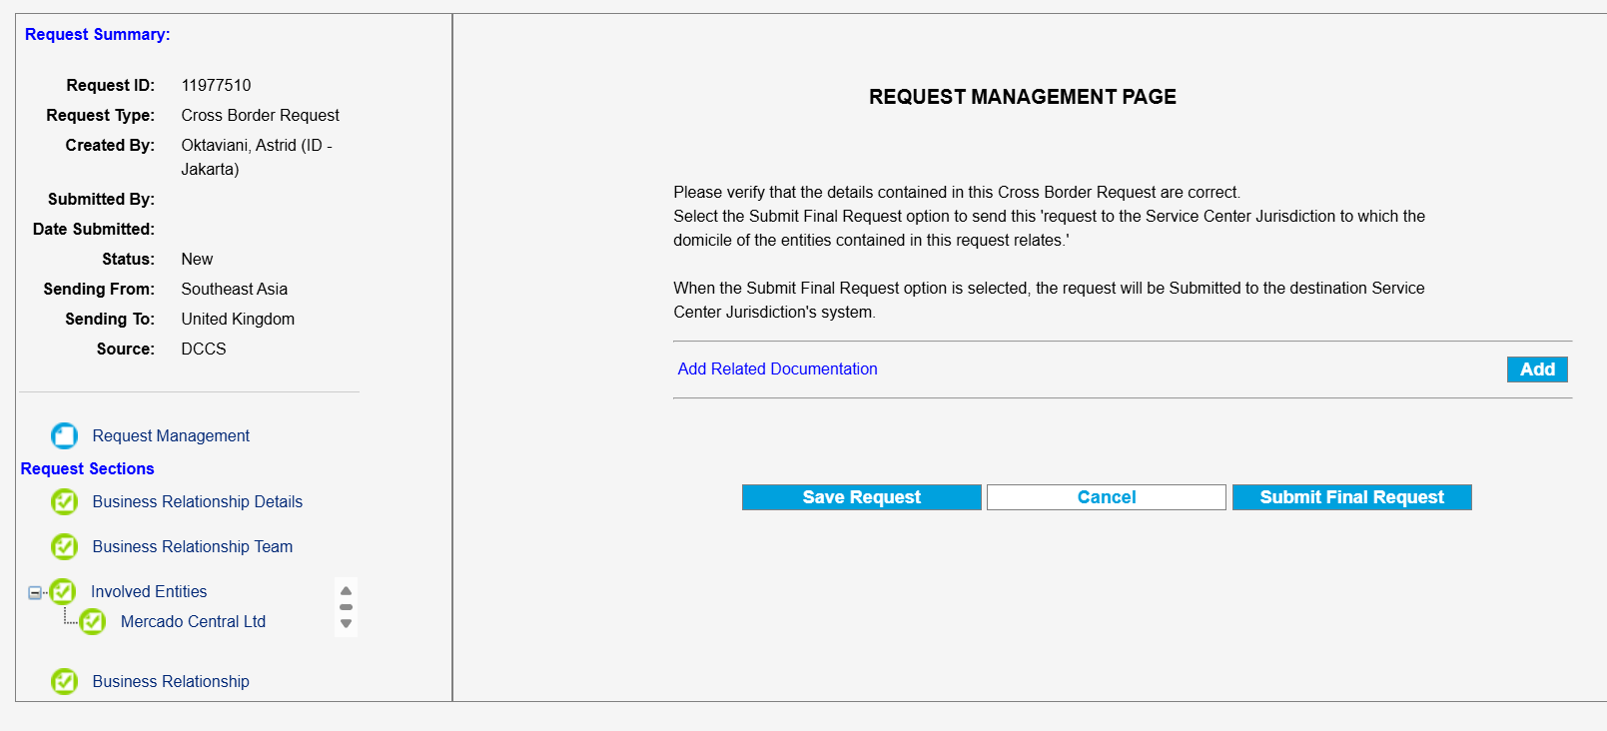

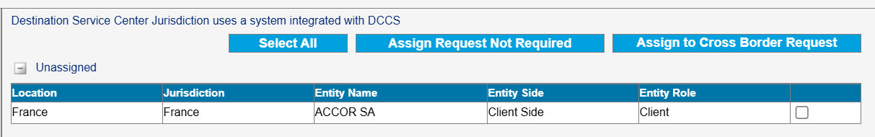
Perform Cross-Border Conflict Check Request to other Member Firms
To send a Cross-Border check to another Member Firm’s jurisdiction:
Go to Cross Border Requests section in the request and click on the Member Firm.
Tick the Involved Entity which requires the cross-border check to be sent.
You will then be directed to Request Management Page of the cross-border check.
Finally, click Submit Final Request button.

Slide 13
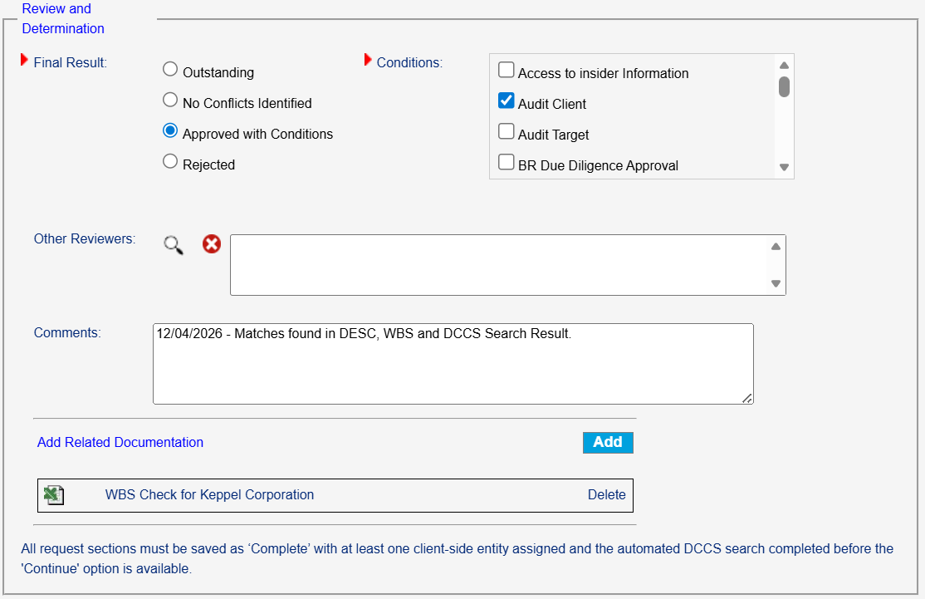
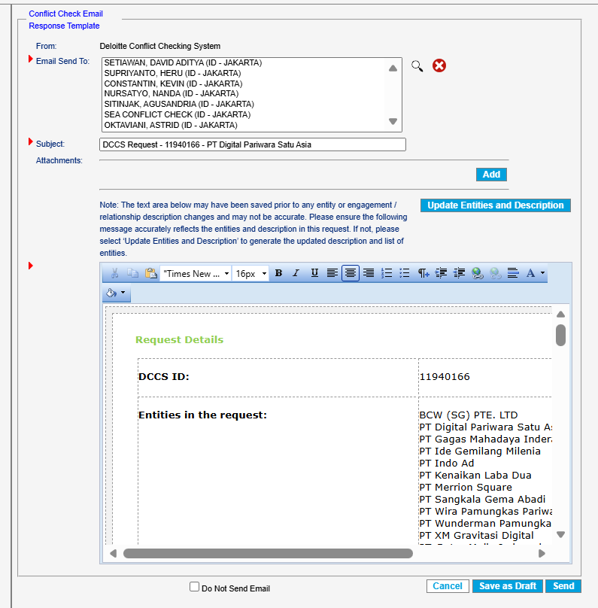
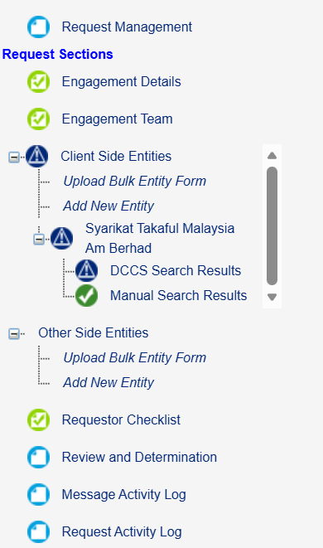
Collate all Relationships identified
Please refer to the SEA Conflicts Protocol for DCCS caveat conditions and approval matrix
Prepare draft conflict check response based on the identified relationships and ensure that:
The draft response is complete and accurate (e.g. status of identified relationships, entity designation, LCSP/EP name, SEA Risk Leaders name, etc.), and
All supporting documentation is attached to the conflict check request (e.g. search results, correspondences with the proposing team/other MFs, consultation emails, etc.)
For Junior analysts, please send draft response to reviewers (Liz, Astrid and Puteri) for further review.
Once all relationships identified are collated or have been reviewed, please go to “Review and Determination” section in DCCS.
For Final Result, please choose “No Conflicts Identified” if no conflicts/no condition indicated in DCCS result, Or choose “Approved with Conditions” if condition is indicated, and select the appropriate conditions (i.e. Audit Client, Restricted Client in DESC, etc.). Then, click “Continue”.
For Conflict Check Email Response Template, please always include SEA Conflict Check mailbox and yourself as the recipient “Email Send To”.
Then, copy and paste the reviewed draft response and click “Send” to release the DCCS result.

Slide 14
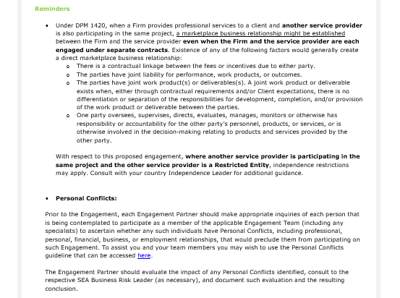
Additional Footer for All SEA T&T Request
Additional footer should be applied to all SEA T&T cases under the 'Reminders' section, prior to 'Personal Conflicts, as follows:
Application of Footer in DCCS Result
Reminders Under DPM 1420, when a Firm provides professional services to a client and another service provider is also participating in the same project, a marketplace business relationship might be established between the Firm and the service provider even when the Firm and the service provider are each engaged under separate contracts. Existence of any of the following factors would generally create a direct marketplace business relationship: There is a contractual linkage between the fees or incentives due to either party. The parties have joint liability for performance, work products, or outcomes. The parties have joint work product(s) or deliverables(s). A joint work product or deliverable exists when, either through contractual requirements and/or Client expectations, there is no differentiation or separation of the responsibilities for development, completion, and/or provision of the work product or deliverable between the parties. One party oversees, supervises, directs, evaluates, manages, monitors or otherwise has responsibility or accountability for the other party’s personnel, products, or services, or is otherwise involved in the decision-making relating to products and services provided by the other party. With respect to this proposed engagement, where another service provider is participating in the same project and the other service provider is a Restricted Entity, independence restrictions may apply. Consult with your country Independence Leader for additional guidance. Personal Conflicts: Prior to the Engagement each Engagement Partner should make appropriate inquiries of each person that is being contemplated to participate as a member of the applicable Engagement Team or Business Relationship team (including any specialists) to ascertain whether any such individuals have Personal Conflicts, including professional, personal, financial, business, or employment relationships, that would preclude them from participating on such Engagement or Business Relationship. To assist you and your team members you may wish to use the Personal Conflicts guideline that can be accessed here. The Engagement Partner should evaluate the impact of any Personal Conflicts identified, consult to the respective SEA Business Risk Leader (as necessary), and document such evaluation and the resulting conclusion.

